Slide 1




Data visualization
01
Parle Company
02
03
PRESENTED BY :
KHUSHI KUSHWAHA
MUSKAN MISHRA
SANCHITA YADAV
SHAGUN GUPTA
GAURI AGRAWAL
NIVEDETA GUPTA

Slide 2
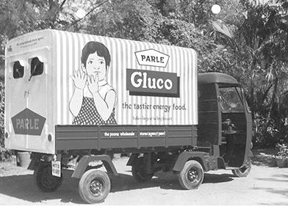

Introduction to Parle Company
01
Founded : 1929 Mohan lal Dayal in Mumbai
Main Business: Biscuits,Confectionery & Snacks
Flagship share: Parle-G(World’s largest selling biscuit)
Market Share : 40% of India’s Biscuit Market
02
03

Slide 3
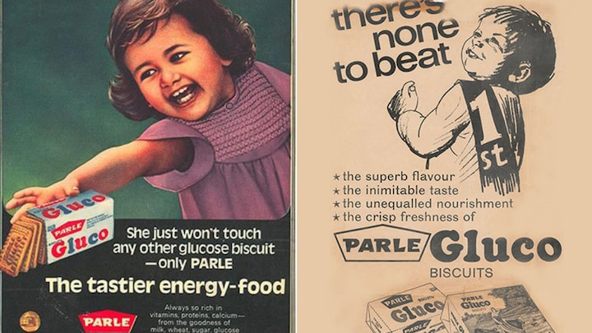
The History
Parle was founded in 1929 in Mumbai by Mohanlal Dayal Chauhan. It began as a small confectionery producing sweets and toffees. In 1939, Parle launched its most iconic product, Parle-G biscuits, which later became one of India’s largest-selling biscuit brands. Over the decades, Parle expanded into snacks, beverages, and confectionery. In 1980s, the company split into three independent units—Parle Products, Parle Agro, and Parle Bisleri—run by different parts of the Chauhan family. Today, Parle Products continues to be a major leader in India’s biscuit and confectionery market.
01
02
03

Slide 4

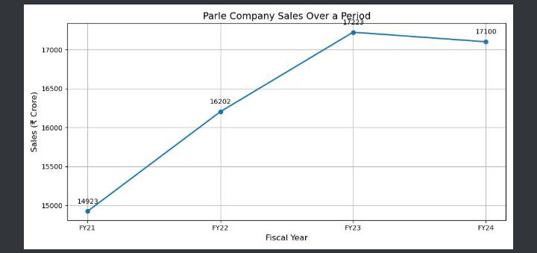
Sales & Revenue Trend
15,086
Total Revenue(crore)
1,607
Net Profit (Crore)
+2%
Revenue growth

Slide 5
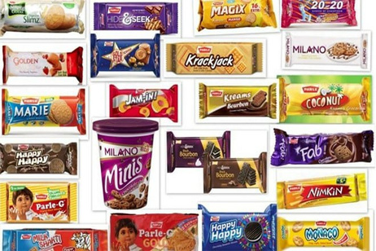

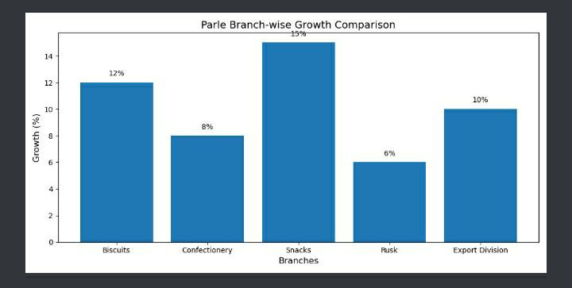
Different Branches & Divisions
01
02
03

Slide 6

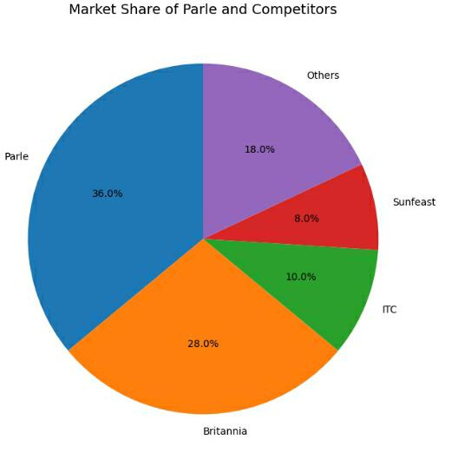


Competitors
01
02
03

Slide 7

Thank You
01
FOR YOUR ATTENTION
02
03

